Slide 1




Enhancing Computational Reproducibility Towards a practical approach
March 11, 2024
CF Data mgmt meeting
Antoine van Kampen
Bioinformatics Laboratory
Epidemiology and Data Science
Amsterdam UMC (AMC)
www.bioinformaticslaboratory.eu
a.h.vankampen@amsterdamumc.nl

Slide 2
Open Science
Reproducibility
Transparency prevention of (conceptual) errors
Open Access
Open Source
Quality
Good scientific practice
Traceability

Slide 3
Reproducibility
Reanalysis of the same data using the same methods produces
the same results.
https://www.ncbi.nlm.nih.gov/books/NBK547546/

Slide 5
ENCORE is not about (FAIR) data management
ENCORE is not only to supplement a final publication
ENCORE is a way of working
ENCORE aims to make computational analysis reproducible

Slide 6
Minimum Information for Biological and Biomedical Investigations
Data
Raw
Processed
Meta data
Samples, experimental design
Sample-data relations
Experiment protocols
Data processing
Temporary storage
(e.g. local hard drive)

Slide 7
CORE facility
(sequencing, metabolomics)
ISA framework
(meta data)
Researcher
Minimum Information for Biological and Biomedical Investigations
Data
Raw
Processed
Meta data
Samples, experimental design
Sample-data relations
Experiment protocols
Data processing
ISA framework
(meta data)
Raw
data
Temporary storage
(e.g. local hard drive)
ISA: 'Investigation' (the project context), 'Study' (a unit of research) and 'Assay' (analytical measurement) ; Rocca-Serra,.....Sansone (2010). Bioinformatics. 26(18), 2354.

Slide 8
CORE facility
(sequencing, metabolomics)
ISA framework
(meta data)
Researcher
Minimum Information for Biological and Biomedical Investigations
Data
Raw
Processed
Meta data
Samples, experimental design
Sample-data relations
Experiment protocols
Data processing
FAIR External data repositories
OMICS repositories
Zenodo, Dataverse
figshare
ISA framework
(meta data)
Raw
data
transfer
SODAR/YODA/WebDav/….
iRODS
Private data storage
(e.g., SURF)
transfer
Temporary storage
(e.g. local hard drive)
transfer
Storage HPC computing
ISA: 'Investigation' (the project context), 'Study' (a unit of research) and 'Assay' (analytical measurement) ; Rocca-Serra,.....Sansone (2010). Bioinformatics. 26(18), 2354.
iRODS: open source data management middleware. Nieminen M (2022) SODAR: managing multiomics study data and metadata. Gigascience. 12, giad052

Slide 9
CORE facility
(sequencing, metabolomics)
ISA framework
(meta data)
Researcher
Minimum Information for Biological and Biomedical Investigations
Data
Raw
Processed
Meta data
Samples, experimental design
Sample-data relations
Experiment protocols
Data processing
FAIR External data repositories
OMICS repositories
Zenodo, Dataverse
figshare
ISA framework
(meta data)
Raw
data
transfer
SODAR/YODA/WebDav/….
Processed
data
iRODS
Private data storage
(e.g., SURF)
Meta data
transfer
Temporary storage
(e.g. local hard drive)
transfer
Storage HPC computing
ISA: 'Investigation' (the project context), 'Study' (a unit of research) and 'Assay' (analytical measurement) ; Rocca-Serra,.....Sansone (2010). Bioinformatics. 26(18), 2354.
iRODS: open source data management middleware. Nieminen M (2022) SODAR: managing multiomics study data and metadata. Gigascience. 12, giad052
ENCORE: open science computational reproducibility (submitted)

Slide 10
CORE facility
(sequencing, metabolomics)
ISA framework
(meta data)
Researcher
Minimum Information for Biological and Biomedical Investigations
Data
Raw
Processed
Meta data
Samples, experimental design
Sample-data relations
Experiment protocols
Data processing
FAIR External data repositories
OMICS repositories
Zenodo, Dataverse
figshare
ISA framework
(meta data)
Raw
data
transfer
SODAR/YODA/WebDav/….
Processed
data
iRODS
Standardized File System Structure (sFSS)
(physical storage)
Private data storage
(e.g., SURF)
Meta data
transfer
transfer
Temporary storage
(e.g. local hard drive)
transfer
Storage HPC computing
ISA: 'Investigation' (the project context), 'Study' (a unit of research) and 'Assay' (analytical measurement) ; Rocca-Serra,.....Sansone (2010). Bioinformatics. 26(18), 2354.
iRODS: open source data management middleware. Nieminen M (2022) SODAR: managing multiomics study data and metadata. Gigascience. 12, giad052
ENCORE: open science computational reproducibility (submitted)

Slide 11

Self-contained
Standardized File System Structure (sFSS)
Information
(Meta) data
Code
Results
Data repositories
Zenodo, Dataverse
figshare
zip
HPC Computing
GitHub organization
account (BioLab)

Slide 12





Data Management
Minimum Information Standards, Vocabularies, Ontologies, Provenance, FAIR
Research question
Sample collection
Experimental design
Sample processing
1
2
Data collection
Study preparation
Data generation
4
Publication
and archiving
3
Computational approaches
Reporting guidelines
STARD, CONSORT, Nature Reporting Summary, software documentation
ENCORE
Computation guidelines
Software standards, FAIR, Software, FACT, workflow systems, environments
FAIR: Findable, Accessible, Interoperable, Re-usable (Wilkinson, Sci Data, 2016)
FACT: Fairness, Accurate, Confidential, Transparent (Van der Aalst, Bus Inf Syst Eng, 2017)

Slide 13
Top-down and bottom-up
Institutions, funders, and journals
Reproducible Research
Best Practices
Guidelines
Scientist-driven

Slide 14
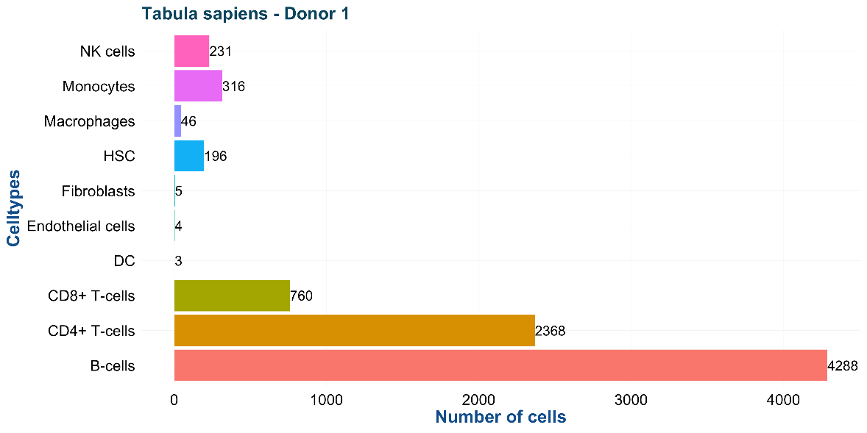
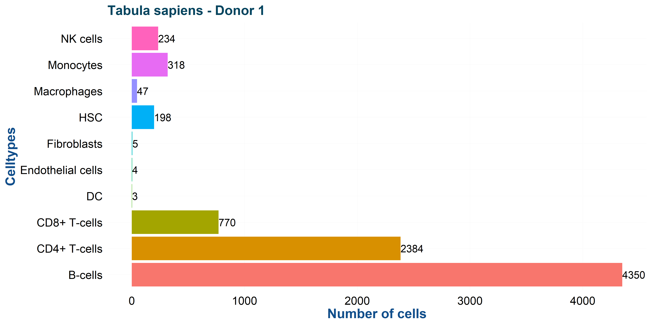
What is the problem?
Mahamune et al, in prep
Initial analysis
231
316
46
196
Spatial transcriptomics
234
318
47
198
Reproduction
It is virtually impossible to
reproduce computational
results
Tabula Sapiens: molecular reference atlas for more than 400 cell types of the human body (single-cell transcriptomics)

Slide 15
What is causing the problem?
Undocumented manual processing steps
Unavailability of software or data
Unclear how software should be used (or which version)
Scripting / bad programming style
Unclear how data was used with the software
Changes in software libraries / software dependencies
Incomplete software documentation
Unspecified parameters
Runtime environment (containers, virtual machines, OS, system tools, availability)
Changing (public) databases
Project organization
Conceptual problems
Random seed
(scientific misconduct)

Slide 16
Why is it so difficult to work reproducible and transparent in practice?
There are sufficient guidelines but translation to
and implementation in practice seems a
bottleneck

Slide 17
What is holding you back?
It’s only the result that matters!
I’d rather do real science than tidy up my data
Reproducibility sounds alright, but my code and data are spread over so many hard drives and directories that it would just be too much work to collect them all in one place.
We can always sort out the code and data after submission
My field is very competitive and I can’t risk wasting time
Markowetz (2015) Gen. Biology, 16, 274

Slide 18
Excuses from the Bioinformatics Laboratory
I don’t have time
It is only overhead
My way of working is already reproducible
My project is too complex to work reproducible
Who would ever want to reproduce my results
We can try it for a while and then go back to business as usual
We can be flexible
Even large companies do not succeed in reproducibility
I only have small projects

Slide 19
“In my own group, I don’t even discuss results with students if they are not documented well.
No proof of reproducibility, no result!”
Markowetz (2015) Gen. Biology, 16, 274

Slide 20
“What has really improved reproducibility in my own lab is to require that, before paper submission, a team member not involved in the project tries to independently run the analyses and reproduce the results”
If results are not reproducible, you just published a “miracle”
Markowetz (2015) Gen. Biology, 16, 274

Slide 21

FAIR nor data/software repositories nor (data) standards nor guidelines alone will make our (computational) research reproducible. It is far more complex……
…..and we need a practical implementation

Slide 22
ENCORE: ENhancing COmputational REproducibility
Overall aim
An (external) colleague not involved in the project should be able to independently run the analyses and reproduce our results
The project should be structured, transparent, traceable, and understandable
All project information should be ‘integrated’
Harmonized approach and best practices across our group (not at individual level)
Not only for publication / archiving!

Slide 23
Why did we initiate ENCORE?
We generally cannot reproduce published results from other groups; even if data and code is available;
We sometimes cannot reproduce our own results
Computational details are generally not transparent (e.g., how to check if we do not make (conceptual) errors in our software);
Requests from collaborators to reproduce/extend what we did for them in the past. (sometimes from years ago).
Continuity of our research and support
Supervisors are (co)responsible for reproducibility (i.e., we need transparency to check and give feedback)
(Prevent scientific misconduct)

Slide 24
Tables
Figures
Intermediate files
Organize & Integrate
OUTPUT
CONCEPTS
CODE
INPUT
Background info
Literature
Lab-journal
(Meta) data
Parameters
R, Python
C++, Matlab
Notebooks

Slide 25
Our approach: sFSS + GitHub
sFSS: standardized File System Structure
Project organisation
Lay out the data and analysis with sufficient transparency and clarity such that the results can be checked
Git / GitHub
Distributed software/documentation version control system
Version control (including branching, merging)
Web-based repository

Slide 26
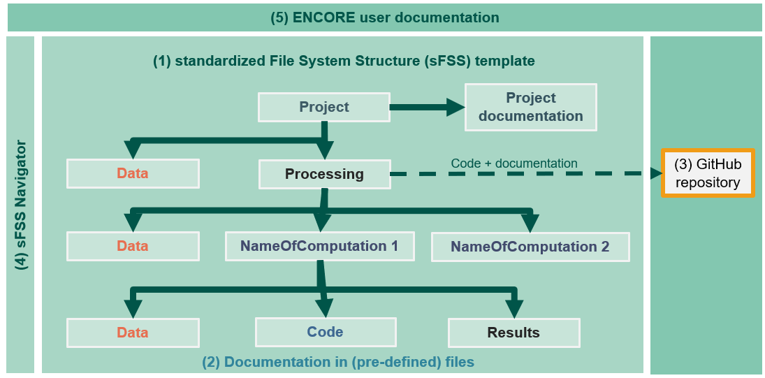
Overall setup
(5) ENCORE user documentation
(1) standardized File System Structure (sFSS) template
Project
Project documentation
Data
Processing
Code + documentation
(3) GitHub
repository
(4) sFSS Navigator
Data
NameOfComputation 1
NameOfComputation 2
Data
Code
Results
(2) Documentation in (pre-defined) files

Slide 27
Standardized File System Structure sFSS
ID_ProjectName 00_README-FIRST.{md, txt}
0_GETTINGSTARTED.{docx, tex, txt, html}
0_PROJECT.md
1_Step-by-Step-ENCORE-Guide.{docx,pdf}
2_CITATION.{md, txt}
Navigate.py / Navigate_U.sh / Test_Navigate_Module.py
Navigation.conf
.navigate
Data 0_README.md
NameOfDataset_1
Meta 0_README.md
Processed 0_README.md
Raw 0_README.md
Processing README.md, github.txt, gitignore-templates
.git
0_SoftwareEnvironment 0_README.md
Anaconda 0_README-General.md, 0_README-ProjectSpecific.md
C++
Matlab
Python
R
Data
NameOfDataset_1
Meta
Processed
Raw
NameOfComputation_1
Code 0_README.md
CodeDocumentation 0_README.md
Data
NameOfDataset_1
Meta
Processed
Raw
NoteBooks 0_README.md
Results 0_README.md
Settings 0_README.md
ProjectDocumentation LabJournal.{docx, tex, md, txt}
BackgroundDocumentation
Literature 0_README.md
MyPresentations 0_README.md
Manuscript 0_README.md
Sharing 0_README.md

Slide 28
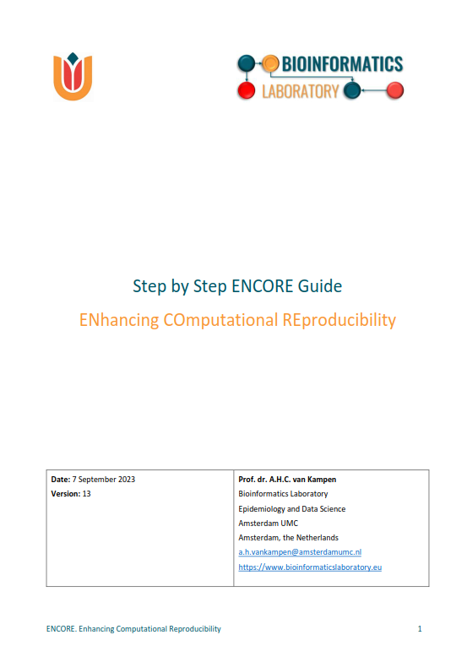
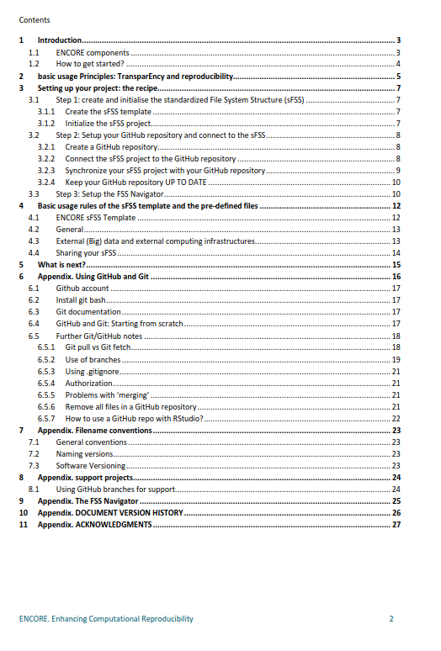

Slide 29
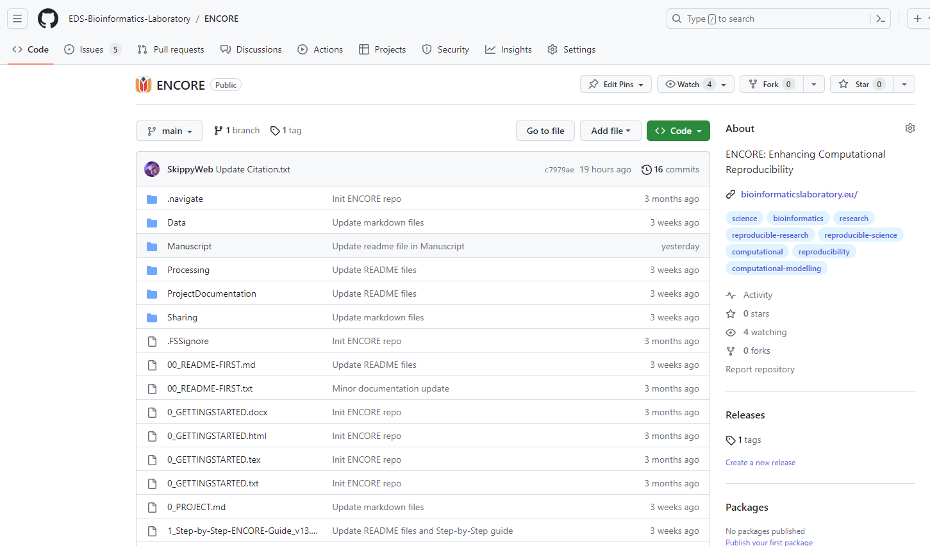
ENCORE Template (GitHub)
https://github.com/EDS-Bioinformatics-Laboratory/ENCORE

Slide 30
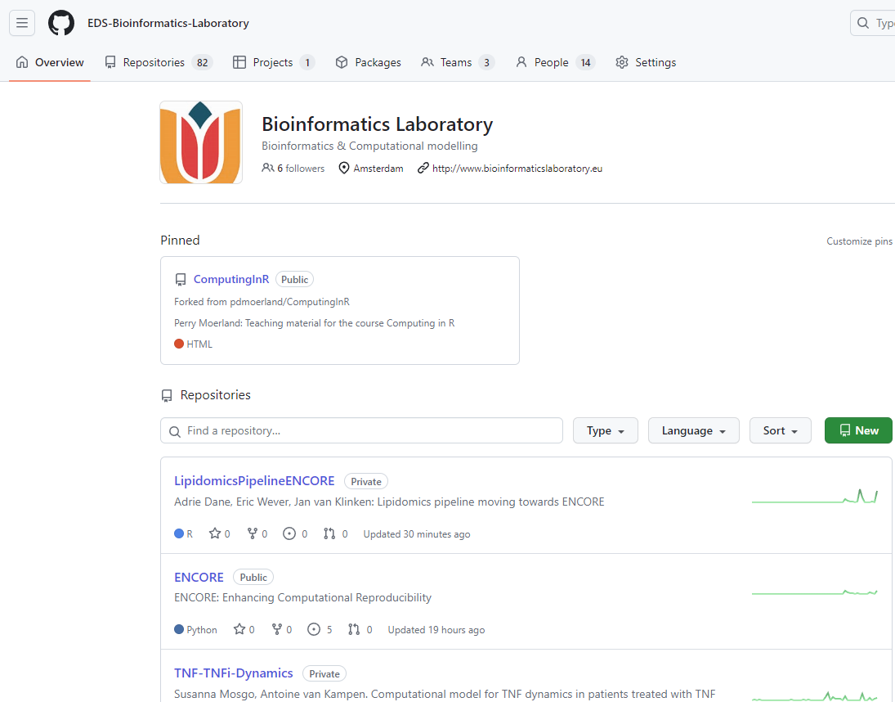

Slide 31
sFSS
Project
Project
Project team
execution
Version
GitHub
repository
Code
control
Share
Researchers
Reviewers
Archiving
Access
(optional)

Slide 32
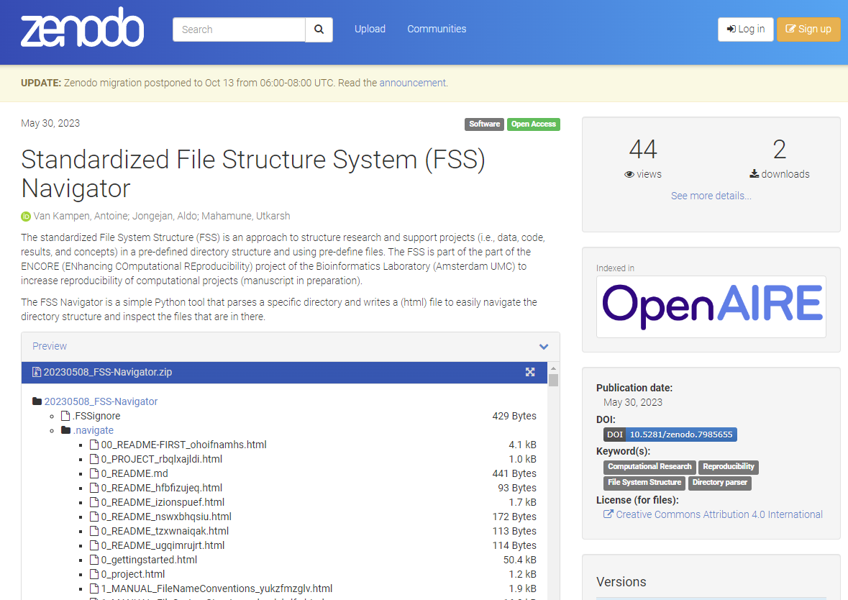

Slide 33
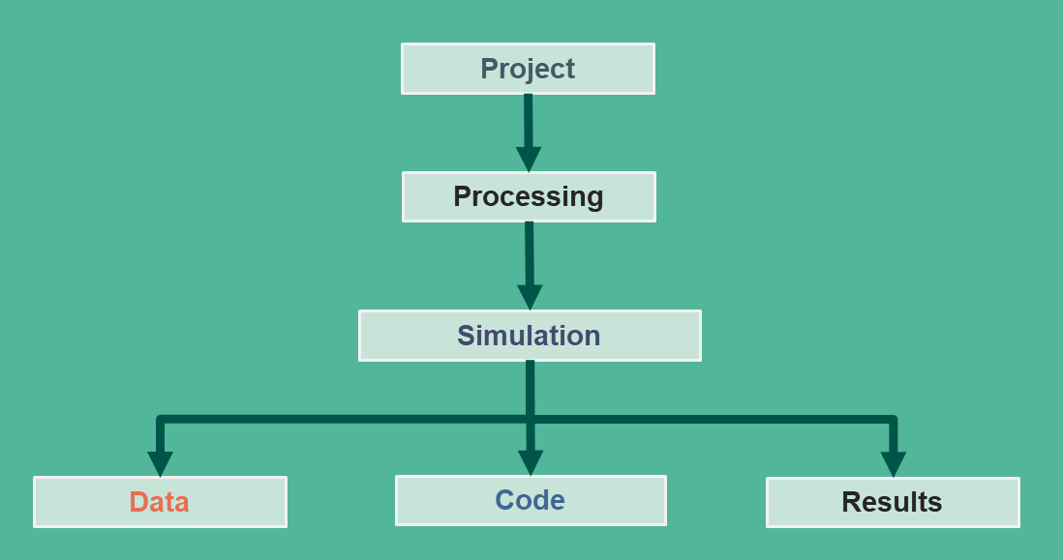



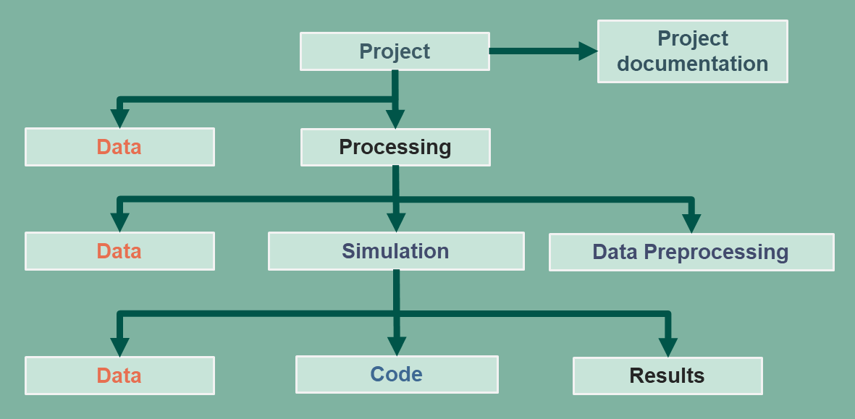
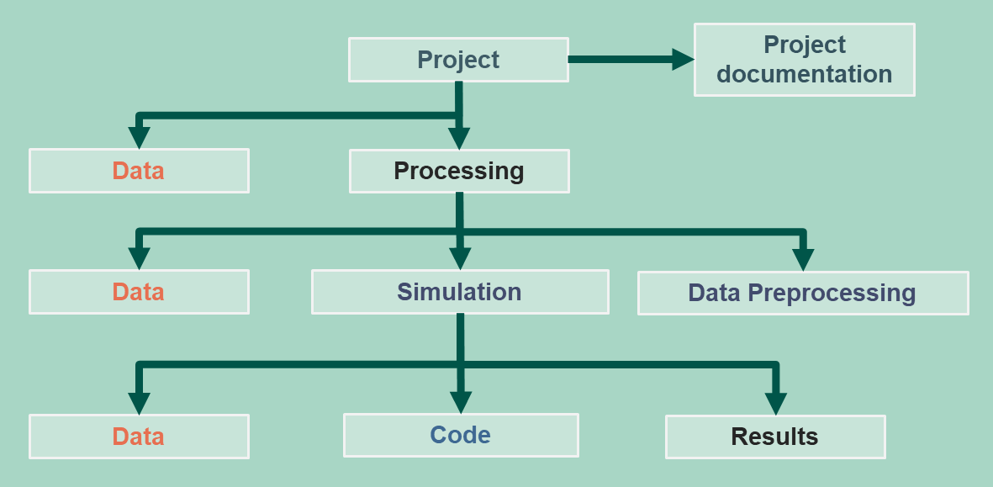
Transfer between ICT research infrastructures
Remote computer system
Cluster, GPU
Transfer
Transfer
Synchronize
Local computer
CLOUD

Slide 34
Documentation
Publications
Reproducibility
BioLab
Discussions
BioLab
Experience
Guidelines
Background &
Philosophy
General
Specific
ENCORE
Publication
Step-By-Step Guide
sFSS
00_README_FIRST
0_GETTINGSTARTED
LabJournal
GitHub README
0_README
Specificity increases with
directory depth

Slide 35
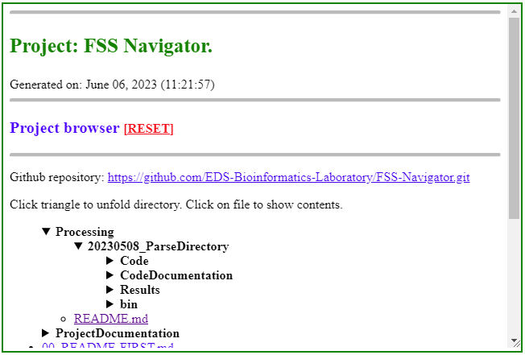
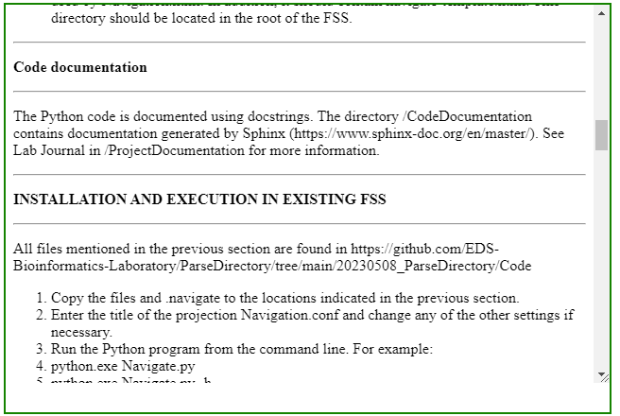
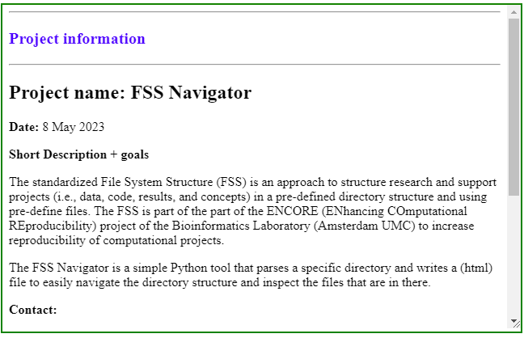
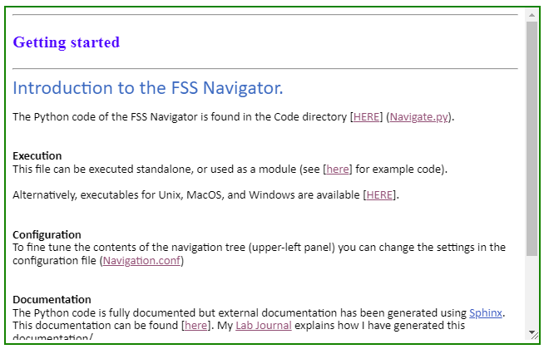
(A)
(B)
(C)
(D)

Slide 36
Develop a “culture of reproducibility”
PIs
Postdocs
PhD students
Junior researchers
Bachelor/Master/HBO/… internship students
Everyone is using FSS/GitHub for every project!

Slide 37
MAIN CHALLENGE: KEEP THE BALANCE
Working
reproducible
Publishing

Slide 38

But……it is really overhead?
Recipe to setup sFSS for new project
~15 - 30 minutes
30 minutes to available initial information
Updating the sFSS during project execution
Minutes?
Research /
Support
Working
reproducible
Low motivation

Slide 39
No one cares!?
Have you ever been asked to reproduce?
Are you really devoted in helping science?
Are you really worried about your (reproducibility) track record?
A scientist needs real credits
Perhaps the most significant challenge to overcome for routine usage of initiatives such as ENCORE is the lack of incentives to sufficiently motivate researchers to spend sufficient time and effort on reproducibility.

Slide 40
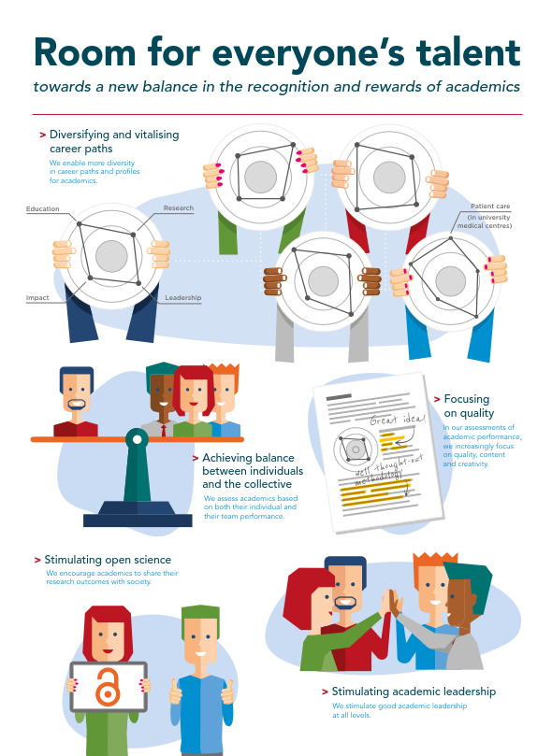
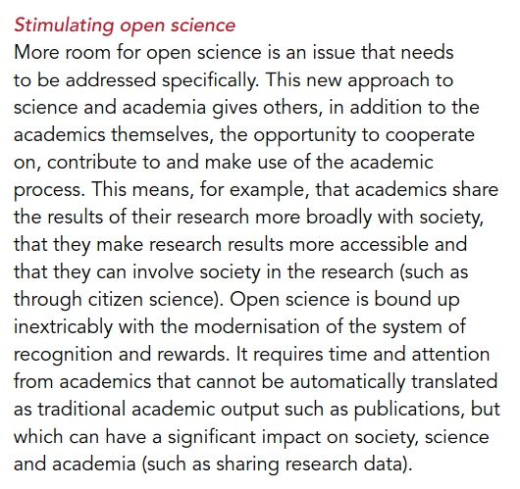


Slide 41
Where to find it?
Publications
van Kampen, A., Mahamune, U., Jongejan, A., van Schaik, B., Balashova, D., Lashgari, D., Pras-Raves, M., Wever, E., Dane, A., Valiente, R.G., and Moerland, P (2024). ENCORE. A Practical Implementation to Improve Reproducibility and Transparency of Computational Research. MetaArXiv, February 19. https://doi.org/10.31222/osf.io/m9yqz.
van Kampen, A., Mahamune, U., Jongejan, A., van Schaik, B., Balashova, D., Lashgari, D., Pras-Raves, M., Wever, E., Dane, A., Valiente, R.G., and Moerland, P (2024). ENCORE. A Practical Implementation to Improve Reproducibility and Transparency of Computational Research. Submitted.
Mahamune, U., Moerland, P., van Baarsen, E., Jongejan, A., and van Kampen, A. (2024). An ENCORE use case: deconvolution methods for spatial transcriptomics data. In prep.
van Kampen, A., Jongejan, A., van Schaik, M., Wever, E., Dane, A., and Moerland, P (2024). Using ENCORE for support projects. In prep.
sFSS Navigator (Zenodo)
Van Kampen AHC, Mahamune U, Jongejan, A (2023) The standardized file system structure (FSS) navigator. Zenodo. DOI: https://doi.org/10.5281/zenodo.7985655
ENCORE Template (GitHub)
https://github.com/EDS-Bioinformatics-Laboratory/ENCORE

Slide 42


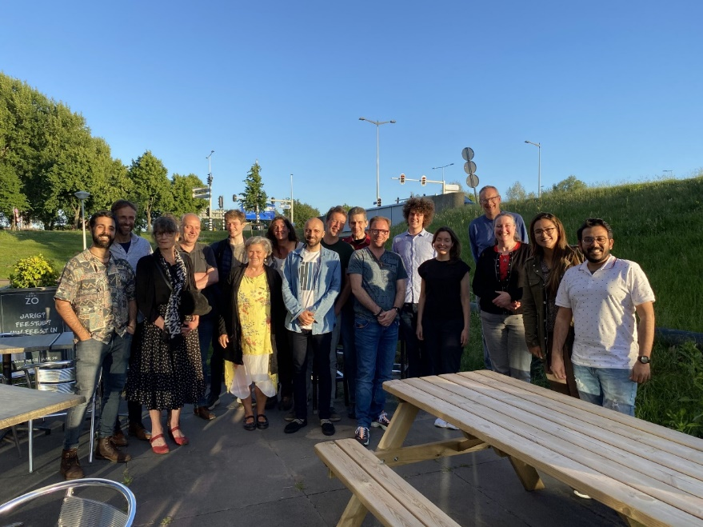

Acknowledgements
COSMIC. Marie Skłodowska-Curie grant agreement No 765158.
ARCAID. Marie Skłodowska-Curie grant agreement No 847551,
CLOSIT. PPP Allowance made available by the Top Sector Life Sciences and Health.
3TR. Innovative Medicines Initiative 2 Joint Undertaking (JU) grant agreement No 831434 (3TR). The JU receives support from the European Union’s Horizon 2020 research and innovation programme and EFPIA.
Bioinformatics Laboratory
Epidemiology and Data Science
Utkarsh Mahamune
Aldo Jongejan
Barbera van Schaik
Daria Balashova
Danial Lashgari
Mia Pras-Raves
Eric Wever
Adrie Dane
Rodrigo García-Valiente
Perry Moerland
Antoine van Kampen
and BSc/MSc/HBO students

Slide 43

You can go now………
…….unless there are questions

